Slide 1
網路安全 之 網路鑑識
教育部
新型態資安實務課程計畫
授課教師:
資訊安全基礎實務課程 A practical introduction to security

Slide 2
Network Forensics

Slide 3
Network Forensics https://en.wikipedia.org/wiki/Network_forensics
http://lmgsecurity.com/nf/
Network forensics is a sub-branch of digital forensics relating to the monitoring and analysis of computer network traffic for the purposes of information gathering, legal evidence, or intrusion detection.
Unlike other areas of digital forensics, network investigations deal with volatile and dynamic information. Network traffic is transmitted and then lost, so network forensics is often a pro-active investigation.
Network forensics generally has two uses.
The first, relating to security, involves monitoring a network for anomalous traffic and identifying intrusions. An attacker might be able to erase all log files on a compromised host; network-based evidence might therefore be the only evidence available for forensic analysis.
The second form relates to law enforcement. In this case analysis of captured network traffic can include tasks such as reassembling transferred files, searching for keywords and parsing human communication such as emails or chat sessions.

Slide 4
Network Forensics
常用工具

Slide 5
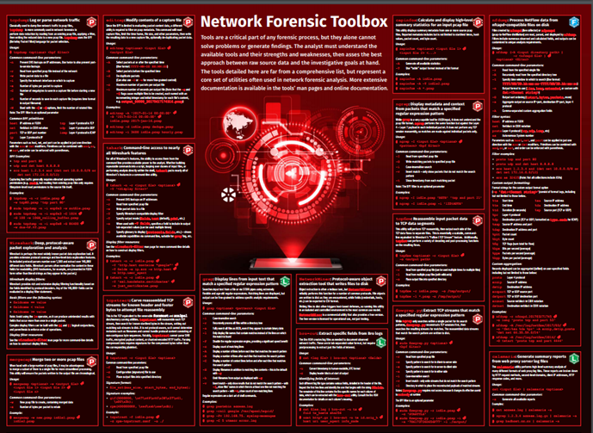
http://www.forensicswiki.org/wiki/Tools:Network_Forensics
https://digital-forensics.sans.org/media/Poster_Network-Forensics_WEB.pdf

Slide 6
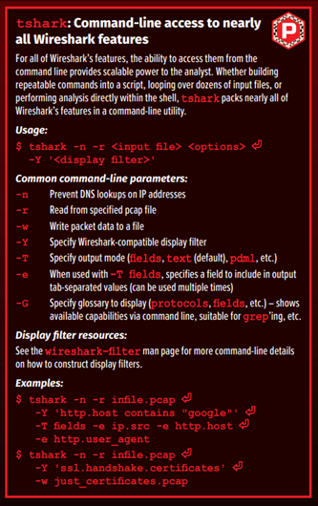
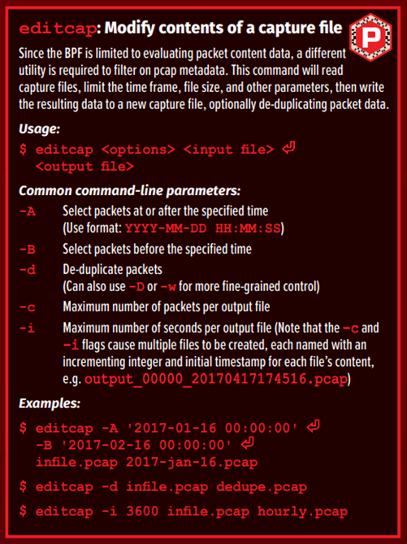

Slide 7
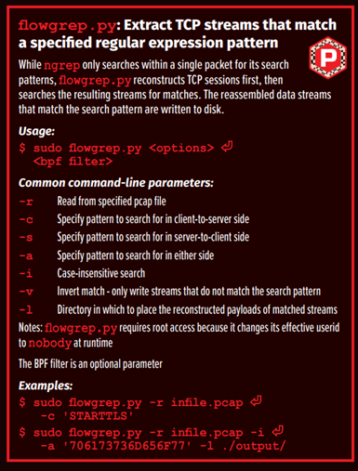
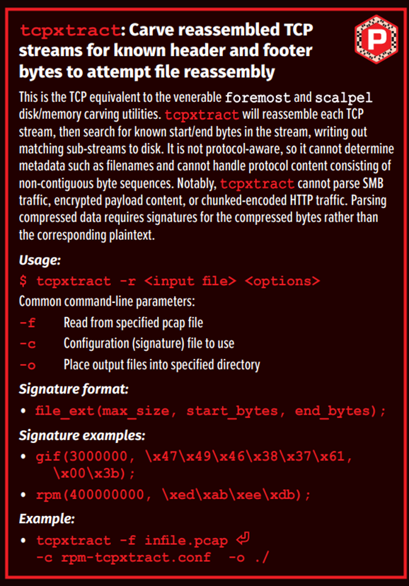

Slide 8



Wireshark https://www.wireshark.org/
https://wiki.wireshark.org/
Wireshark（前稱Ethereal）是一個免費開源的網路封包分析軟體
網路封包分析軟體的功能是截取網路封包，並盡可能顯示出最為詳細的網路封包資料。
Stable Release (2.4.2) • October 10, 2017
Wireshark使用情境:
網路管理員使用Wireshark來檢測網路問題
網路安全工程師使用Wireshark來檢查資訊安全相關問題
開發者使用Wireshark來為新的通訊協定除錯
普通使用者使用Wireshark來學習網路協定的相關知識

Slide 9
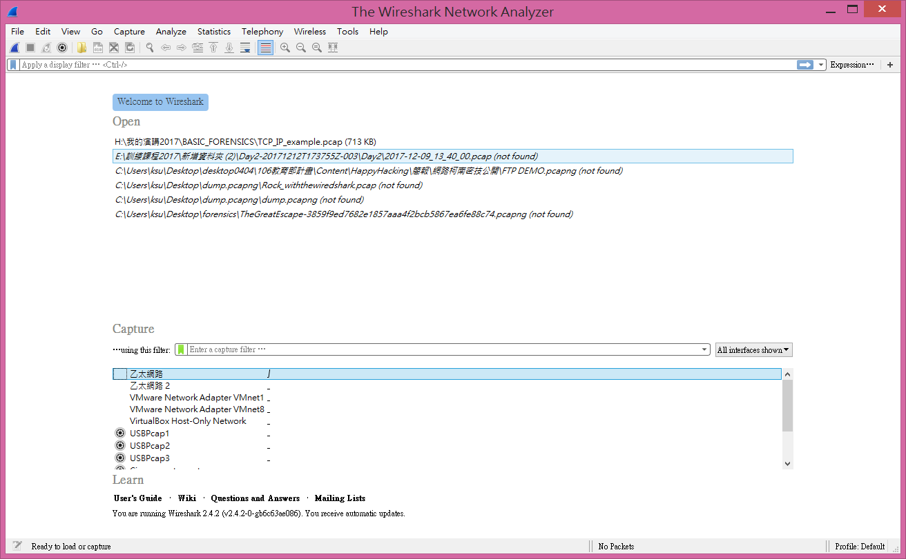
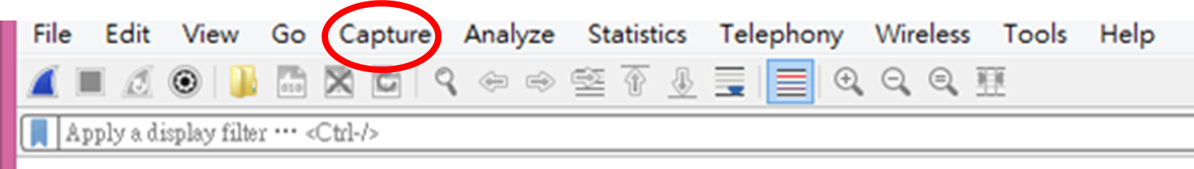
Wireshark https://www.wireshark.org/

Slide 10
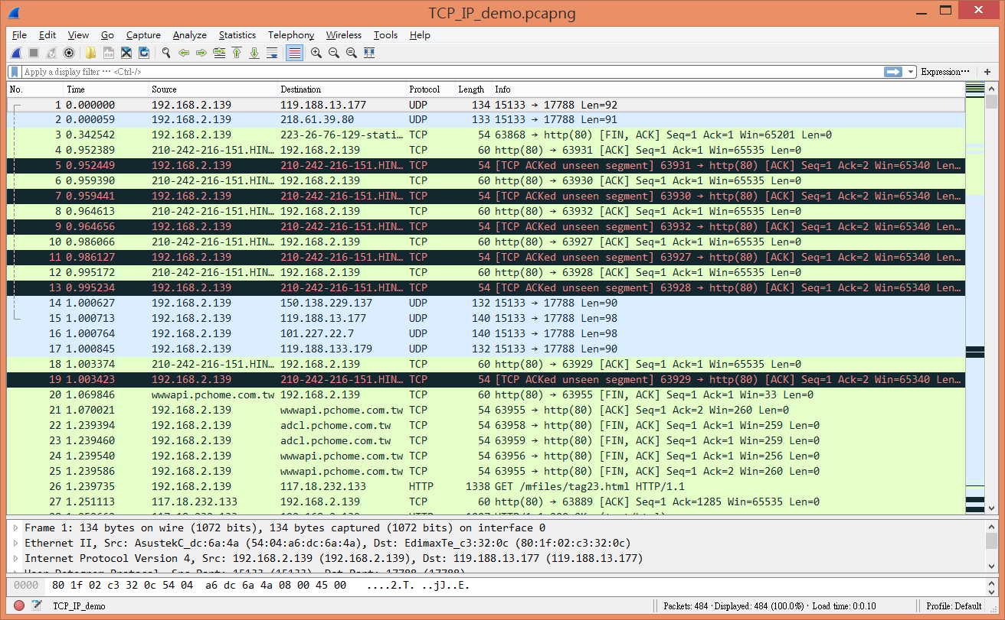
編號
時間
長度
訊息
來源IP
目的IP
協定

Slide 11
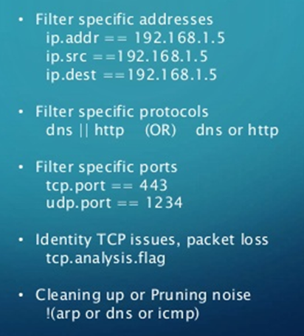
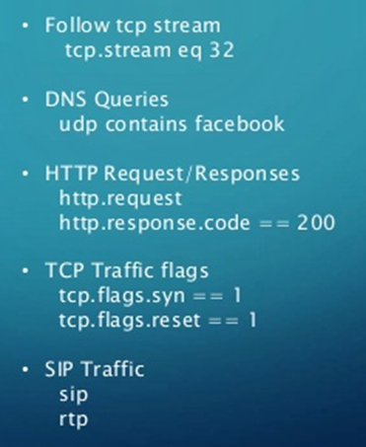
Wireshark 善用filter找出需要分析的封包 https://www.wireshark.org/

Slide 12
Wireshark常用封包過濾條件
http://opencourse.ncyu.edu.tw/ncyu/file.php/15/week11/%E5%B0%81%E5%8C%85%E6%93%B7%E5%8F%96%E8%88%87%E5%88%86%E6%9E%90.pdf
類型 |  | 作用說明 | 範例
eth | dst | 目的 MAC | eth.dst == ff:ff:ff:ff:ff
 | src | 來源 MAC | eth.src == 00:e0:18:64:ce:f2
 | addr | MAC 位址 | eth.addr == ff:ff:ff:ff:ff
 | type | 下一層協定 | eth.type == 0x0800(IP) eth.type == 0x0806(ARP)
ip | dst | 目的 IP | ip.dst==140.134.4.1
 | src | 來源 IP | ip.src == 140.134.30.72
 | addr | IP 位址 | ip.addr ==140.134.30.72
 | proto | 下一層協定 | ip.proto == 0x06(TCP) ip.proto == 0x01(ICMP) ip.proto == 0x11(UDP)
tcp | dstport | 目的 Port | tcp.dstport == 80(HTTP)
 | scrport | 來源 Port | tcp.scrport ==21(FTP)
 | port | Port 編號 | tcp.port ==23(Talnet)
udp | dstport | 目的 Port | ucp.dstport == 53(DNS)
 | scrport | 來源 Port | ucp.scrport == 69(TSTP)
 | port | Port 編號 | ucp.port == 53

Slide 13
Chapter 05 著色規則和資料封包匯出
5.1 認識著色規則
5.2 禁用著色規則
5.3 建立使用者著色規則
5.4 匯出資料封包
Chapter 06 構建圖表
6.1 資料統計表
6.2 協定分層統計
6.3 圖表化顯示頻寬使用情況
6.4 專家資訊
6.5 建置各種網路錯誤圖表
Chapter 07 重組資料
7.1 重組Web 階段
7.2 重組FTP 階段
Chapter 08 新增註釋
8.1 捕捉檔案註釋
8.2 封包注釋
8.3 匯出封包註釋
Chapter 09 捕捉、分割和合併資料
9.1 將大檔案分割為檔案集
9.2 合併多個捕捉檔案
9.3 命令列捕捉資料
9.4 匯出欄位值和統計資訊
Chapter 02 設定Wireshark 視圖
2.1 設定Packet List 面板列
2.2 Wireshark 分析器及Profile 設定
2.3 資料封包時間延遲
Chapter 03 捕捉篩檢程式技巧
3.1 捕捉篩檢程式簡介
3.2 選擇捕捉位置
3.3 選擇捕捉介面
3.4 捕捉乙太網資料
3.5 捕捉無線資料
3.6 處理大數據
3.7 處理隨機發生的問題
3.8 捕捉以MAC/IP 位址為基礎資料
3.9 捕捉通訊埠應用程式資料
3.10 捕捉特定ICMP 資料
Chapter 04 顯示技巧
4.1 顯示篩檢程式簡介
4.2 使用顯示篩檢程式
4.3 編輯和使用預設顯示篩檢程式
4.4 過濾顯示HTTP
4.5 過濾顯示DHCP
4.6 根據地址過濾顯示
4.7 過濾顯示單一的TCP/UDP 階段
4.8 使用複雜運算式過濾
4.9 發現通訊延遲
4.10 設定顯示篩檢程式按鈕
第2 篇 網路通訊協定分析篇
Chapter 10 ARP 協定封包截取分析
Chapter 11 網際網路協定（IP）封包截取分析
Chapter 12 UDP 協定封包截取分析
Chapter 13 TCP 協定封包截取分析
Chapter 14 ICMP 協定封包截取分析
Chapter 15 DHCP 資料封包截取分析
Chapter 16 DNS 封包截取分析
Chapter 17 HTTP 協定封包截取分析
Chapter 18 HTTPS 協定封包截取分析
Chapter 19 FTP 協定封包截取分析
Chapter 20 電子郵件封包截取分析
第3 篇 實戰篇
Chapter 21 作業系統啟動過程封包截取分析
第1 篇 Wireshark 應用篇
Chapter 01 Wireshark 的基礎知識
1.1 Wireshark 的功能
1.2 安裝Wireshark
1.3 Wireshark 捕捉資料
1.4 認識資料封包
1.5 捕捉HTTP 封包
1.6 存取Wireshark 資源
1.7 Wireshark 快速入門
1.8 分析網路資料
1.9 開啟其他工具捕捉的檔案
USB檔案copy
手寫板寫字

Slide 14

推薦好書
第1章：封包分析與網路基本觀念
何謂封包分析？它如何運作？本章涵蓋網路通訊和封包分析的一切基礎知識。
第2章：開始傾聽線路
第3章：WIRESHARK簡介
第4章：處理捕捉到的封包
第5章：Wireshark的進階功能
第6章：以指令列進行封包分析
教你如何使用TShark和tcpdump這兩種最佳的指令列封包分析工具。
第7章：網路層協定
第8章：傳輸層協定
第9章：常見上層協定
第10章：真實世界裡的基本情境
第11章：與遲緩的網路對抗::如何解決網路效能不彰
第12章：資安封包分析
第13章：無線網路封包分析

Slide 15
Network Forensics@CTF

Slide 16
CTF
bitsctf-2017/forensic/woodstock-1-10

Slide 17
題目敘述
Someone intercepted a chat between illustris and codelec
題目附檔::ws1_2.pcapng

Slide 18
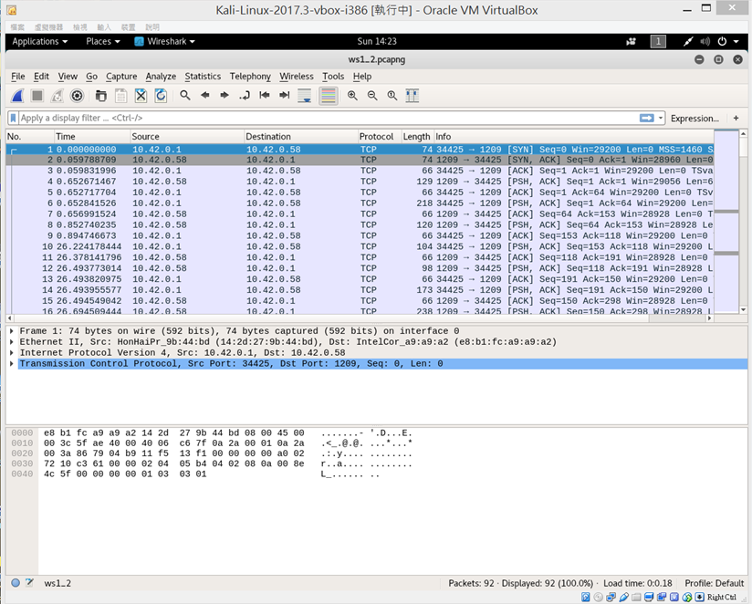
root@kali:~/Desktop# strings ws1_2.pcapng | grep BITSCT
$MyPass BITSCTF{such_s3cure_much_w0w}|

Slide 19
CTF
traffic-1b2b39e2c2231e6b98c77700da047b78.pcapng
HITCON CTF 2017::Data & Mining

Slide 20
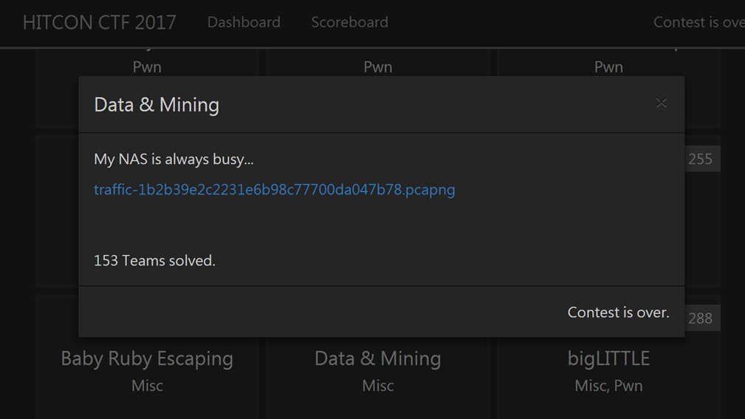
題目敘述

Slide 21
root@kali:~/Desktop# strings traffic-1b2b39e2c2231e6b98c77700da047b78.pcapng | grep hitcon
{"method":"login","params":{"login":"45duiDz79Y2AtSZH2pw9uV8YXmvtAT8tVNAYrfKTUnYiQZT5BMdRrGD4hbipmZ5DoaQXLak9ENEwYNC7kVk3ivDyMHyZCVV","pass":"hitcon{BTC_is_so_expensive_$$$$$$$}","agent":"xmr-stak-cpu/1.3.0-1.5.0"},"id":1}

Slide 22
CTF
>>> import base64
>>> base64.b64encode("CTF")
'Q1RG'
答案格式::CTF{…………………….}
Google CTF 2016: No Big Deal
https://github.com/ctfs/write-ups-2016/tree/master/google-ctf-2016/forensics/no-big-deal-50

Slide 23
題目敘述
Sometimes the answer is immediately obvious, sometimes it's obscured.
Find the answer in here https://storage.googleapis.com/ctf-staging-challenges/no-big-deal.pcap.gz
題目附檔::no-big-deal.pcap.gz

Slide 24
root@kali:~/Desktop# strings no-big-deal.pcap
…………………………………………………………………………………
_BHRfS_M
Q1RGe2JldHRlcmZzLnRoYW4ueW91cnN9
2 Wy7
!gDf
_BHRfS_M
Q1RGe2JldHRlcmZzLnRoYW4ueW91cnN9
`gDf
2 WK
root@kali:~/Desktop# echo 'Q1RGe2JldHRlcmZzLnRoYW4ueW91cnN9' | base64 -d
CTF{betterfs.than.yours}

Slide 25
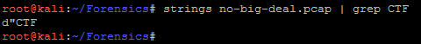
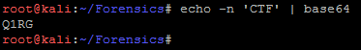
解題(1)
https://github.com/EspacioTeam/write-ups/tree/master/2016/Google/No_Big_Deal
strings no-big-deal.pcap | grep CTF
過濾CTF字串沒什麼發現
echo -n 'CTF' | base64
將CTF字串做base64編碼

Slide 26
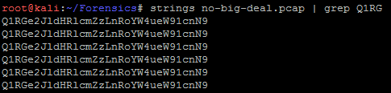
解題(1)
https://github.com/EspacioTeam/write-ups/tree/master/2016/Google/No_Big_Deal
strings no-big-deal.pcap | grep Q1RG
過濾Q1RG字串發現關鍵字串
echo -n 'Q1RGe2JldHRlcmZzLnRoYW4ueW91cnN9' | base64 -d
將關鍵字串做base64解碼

Slide 27
CTF
Network forensics
misc70: Rock with the wired shark!
https://github.com/internetwache/Internetwache-CTF-2016/blob/master/tasks/misc70/solution/description.md
https://github.com/internetwache/Internetwache-CTF-2016/tree/master/tasks/misc70
http://www.10tiao.com/html/607/201603/403778633/4.html

Slide 28
題目敘述
The shark won't bite you.
Don't worry, it's wired!
題目附檔::dump.pcapng

Slide 29
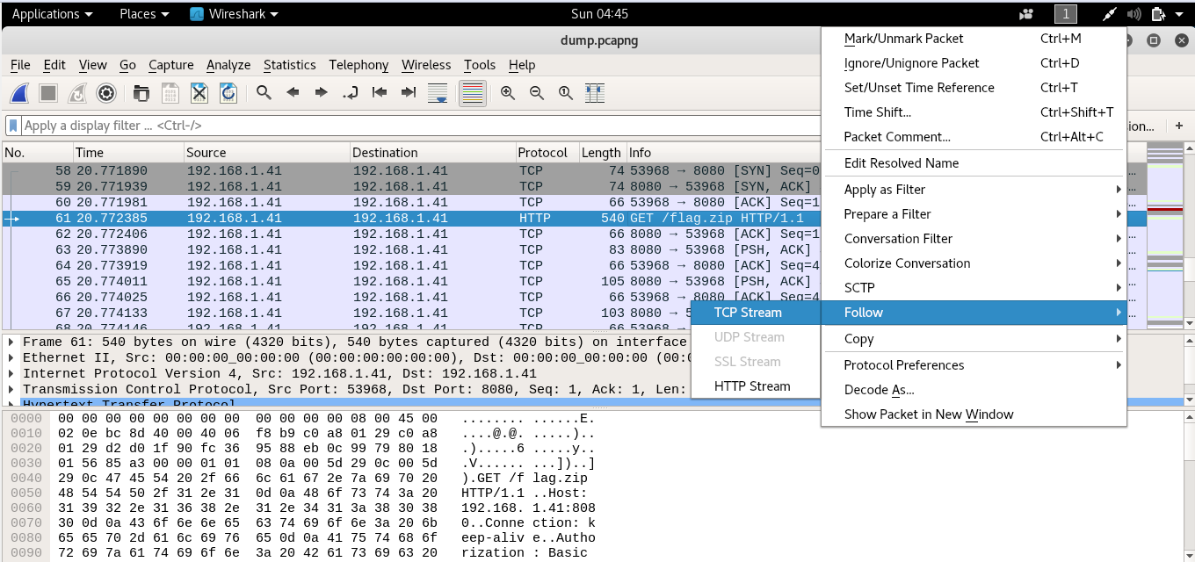
解題(1)
1
3
2

Slide 30
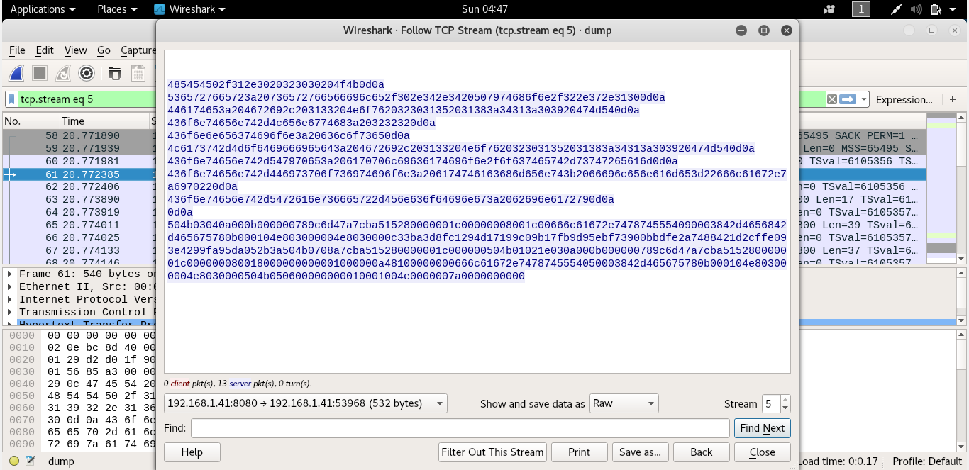
解題(2)
1
2
3

Slide 31
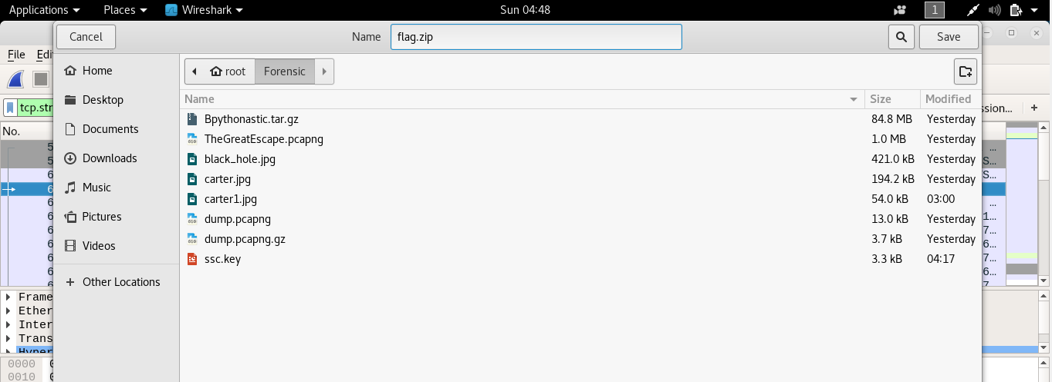
解題(3)
2
1

Slide 32
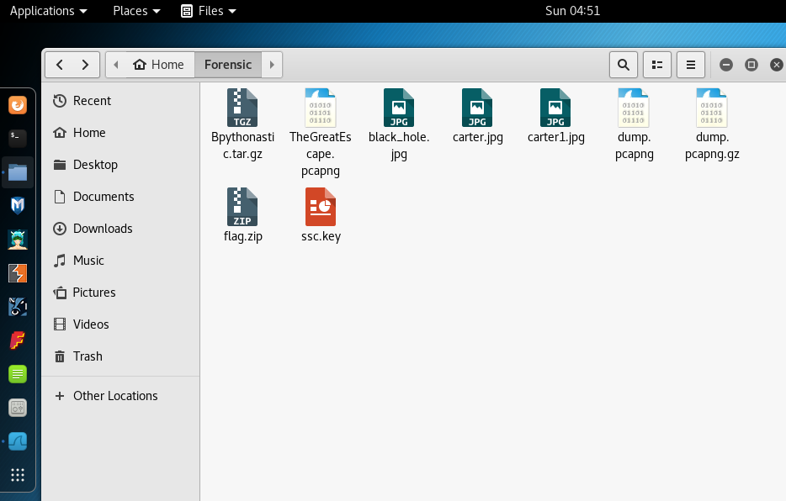
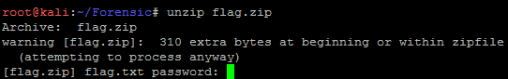
解題(4)
unzip flag.zip
解壓縮需要密碼

Slide 33
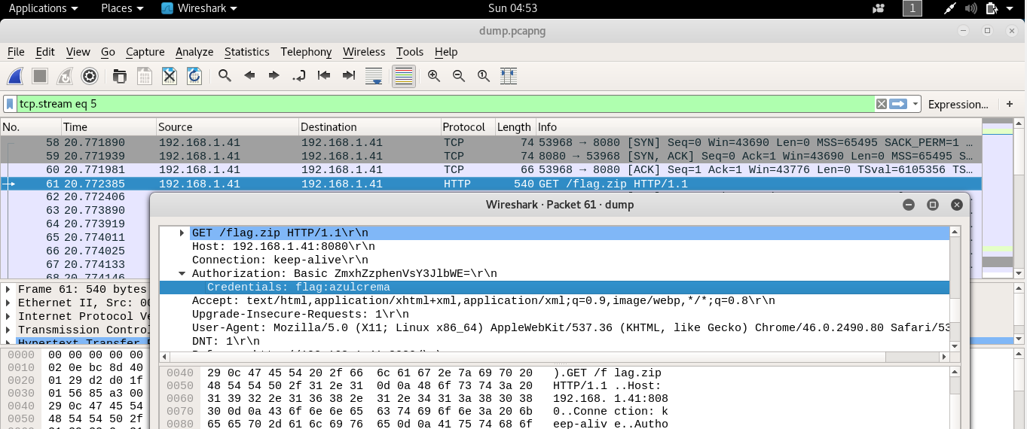
解題(5)

Slide 34
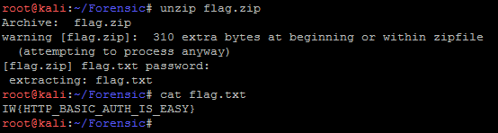
解題(6)
unzip flag.zip
azulcrema
cat flag.txt

Slide 35
自我學習主題:Tshark

Slide 36
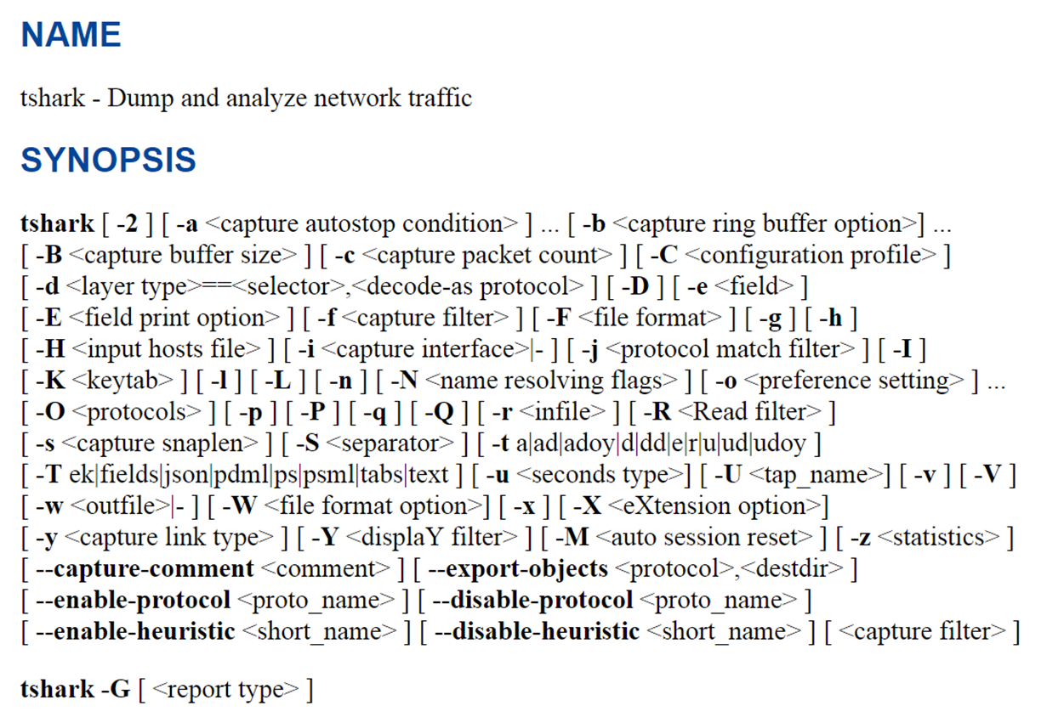
Tshark https://www.wireshark.org/docs/man-pages/tshark.html
TShark is a network protocol analyzer.
It lets you capture packet data from a live network, or read packets from a previously saved capture file, either printing a decoded form of those packets to the standard output or writing the packets to a file. TShark's native capture file format is libpcap format, which is also the format used by tcpdump and various other tools.
Without any options set, TShark will work much like tcpdump. It will use the pcap library to capture traffic from the first available network interface and displays a summary line on stdout for each received packet.
TShark is able to detect, read and write the same capture files that are supported by Wireshark. The input file doesn't need a specific filename extension; the file format and an optional gzip compression will be automatically detected.

Slide 37
tshark常用指令 https://read01.com/zh-tw/KBnx4.html#.Wf8qPVuCyUk
指令 | 說明
tshark -v | 查明tshark版本[順便確定tshark是否已正確安裝]
sudo tshark -D | 列出可用網絡接口 [普通使用者無權直接存取網絡接口設備]
tshark -f | 側錄時過濾的規則
tshark -R | 過濾已側錄完畢的封包
tshark -i eth0 -w abc.cap | 側錄eth0網路介面卡的封包儲存成abc.cap
tshark -i eth0 -f "tcp port 80" | 側錄eth0網路介面卡的 80 Port 的封包
tshark -r /tmp/test.cap | 讀取封包
捕捉數據::最簡單的辦法就是運行不帶任何參數的tshark，這會在螢幕上顯示所有數據。
停止數據捕獲::只要按Ctrl-C組合鍵，就可以停止數據捕獲。
https://read01.com/KBnx4.html

Slide 38
tshark常用指令 https://my.oschina.net/chuangpoyao/blog/67377
指令 | 說明
-i eth0 | 側錄eth0網路介面
-s 512 | 只抓取前512封包長度
-n | 禁止Domain解析
-V | 封包樹狀解析
-x | 十六進制，ASCII 解析
-i <界面> -w <檔名> | 指定界面，儲存檔名
-r <讀檔名> -R <過濾條件> -w <存檔名> | 讀檔，過濾條件，存檔
-z conv,tcp | 統計TCP connection
-f 'tcp dst port 3306' | 只側錄協議為tcp,目的Port為3306的封包
-R ' mysql .query' | 過濾出mysql .query
-T fields -e mysql.query | 印出mysql查詢語句
https://www.centos.bz/2014/07/linux-commandline-capture-packets-tshark-wireshark/

Slide 39
延伸學習主題:
More Network Forensics Tools

Slide 40

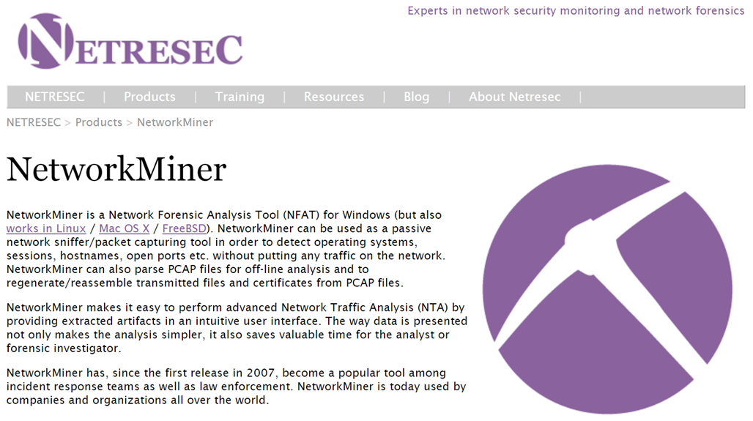
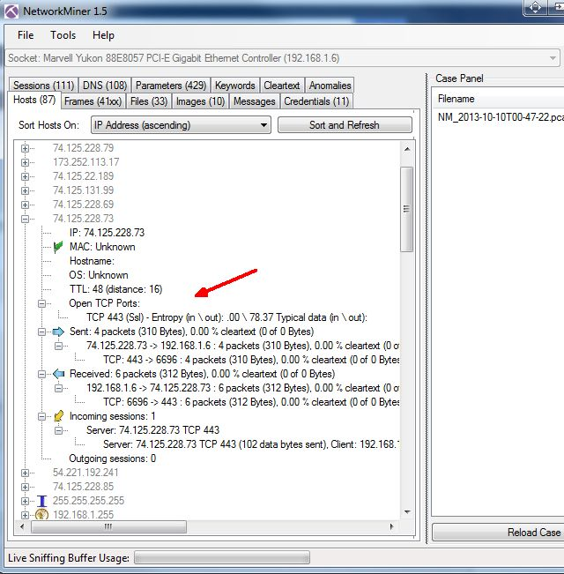
NetworkMiner http://www.netresec.com/?page=NetworkMiner

Slide 41
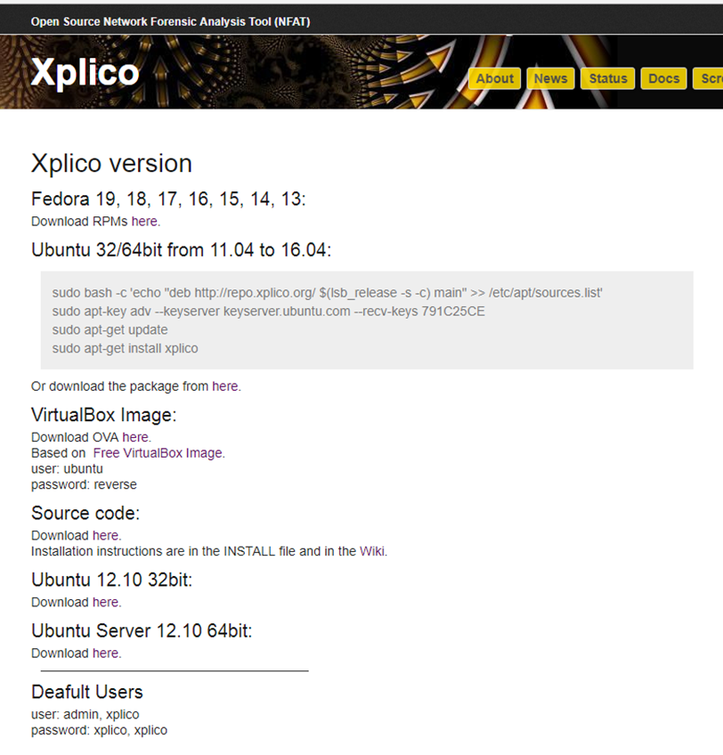
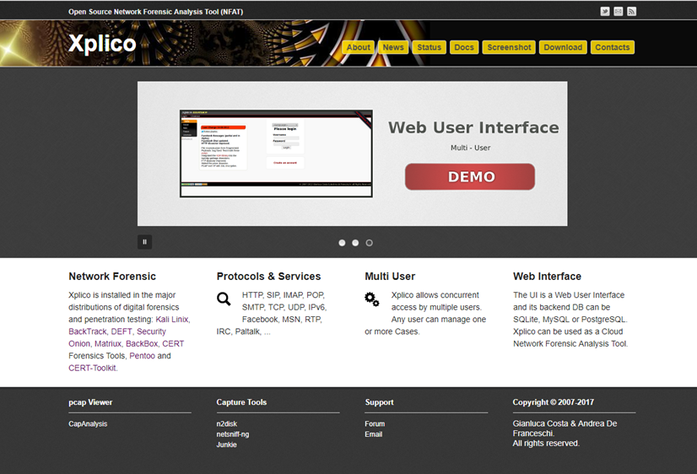
Open Source Network Forensic Analysis Tool (NFAT) https://www.xplico.org/
https://en.wikipedia.org/wiki/Xplico

Slide 42
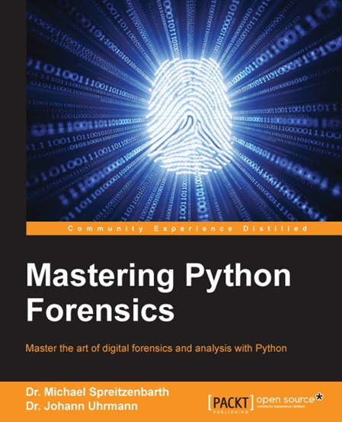

Scapy: the python-based interactive packet manipulation program & library http://www.secdev.org/projects/scapy/
https://github.com/secdev/scapy
Scapy is a powerful Python-based interactive packet manipulation program and library.
It is able to forge or decode packets of a wide number of protocols, send them on the wire, capture them, match requests and replies, and much more. It designed to allow fast packet prototyping by using default values that work.
It can easily handle most classical tasks like scanning, tracerouting, probing, unit tests, attacks or network discovery (it can replace hping, 85% of nmap̀, arpspoof, arp-sk, arping, tcpdump, wireshark, p0f, etc.).
It also performs very well at a lot of other specific tasks that most other tools can't handle, like sending invalid frames, injecting your own 802.11 frames, combining techniques (VLAN hopping+ARP cache poisoning, VoIP decoding on WEP protected channel, ...), etc.
On most systems, using Scapy is as simple as running the following commands:
git clone https://github.com/secdev/scapy
cd scapy
./run_scapy
>>>
http://scapy.readthedocs.io/en/latest/installation.html
BsidesSF 2017 - Dnscap (forensics, 500 pts)
https://github.com/jrmdev/ctf-writeups/tree/master/bsidessf-2017/dnscap

Slide 43

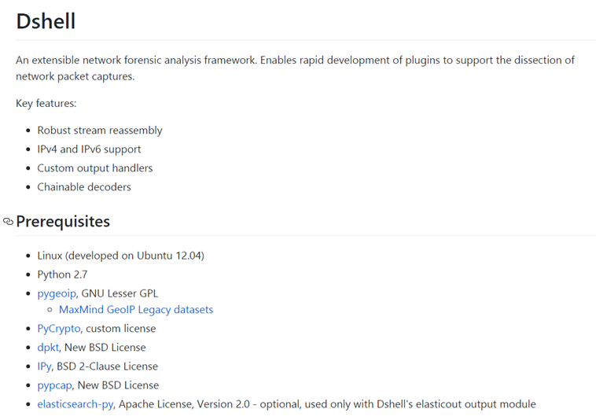
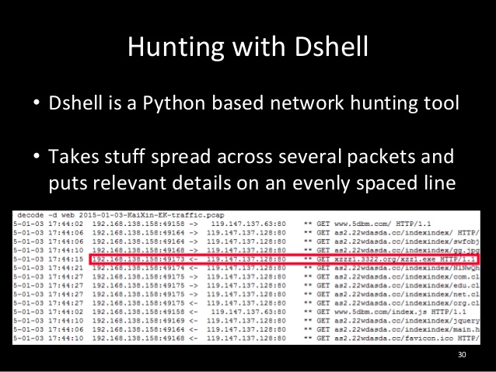

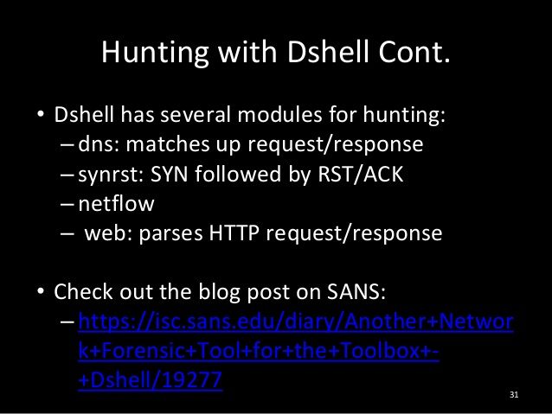
Dshell ::network forensic analysis framework https://github.com/USArmyResearchLab/Dshell
https://www.slideshare.net/j0b1n/bsidescharm2015info-sec-huntersgathers

